Slide 1
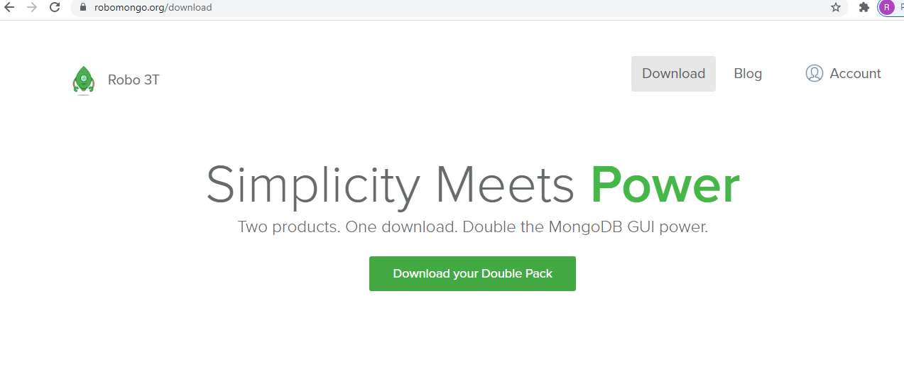
Install Studio 3T On Windows
https://robomongo.org/download

